Slide 1
topic - IPL win probability predictor using machine Learning
Group Members-
Ketan Sharad Dhangar Prasen Balasaheb Waikar
Diksha Anantrao Mohod
Rohini Bhimrao Role
Project guide
P Prof .Komal Jadhav
d
Notes:
NOTE:
To change the image on this slide, select the picture and delete it. Then click the Pictures icon in the placeholder to insert your own image.

Slide 2
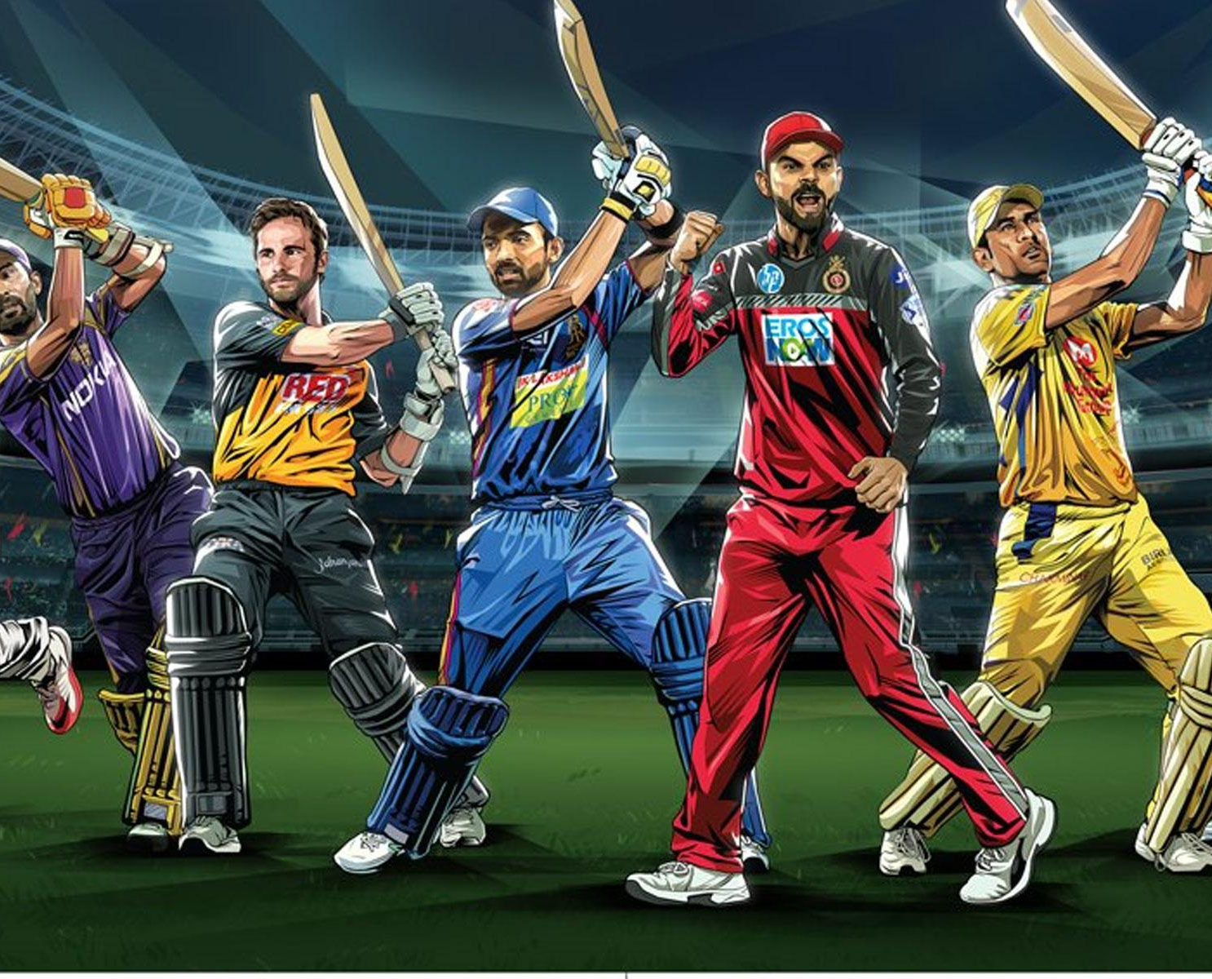
IPL win probability predictor using machine Learning

Slide 3
INTRODUCTION
Hello, everyone.✋
We know the IPL season is going on and we are all eager to know who will win the match beforehand and in the media, there is hype around the winning chances.
What if I say we can make an app that can predict the outcome, Yeah! with the power of Machines you can do these types of amazing stuff and this article is all about it.
In particular, here we will be looking at how you can train a model from scratch and embed it in the web app using simple and powerful libraries like sklearn, pandas, and flask. Also, some web development is involved.

Slide 4
Abstract
Since the dawn of the IPL in 2008, it has attracted viewers all around the globe. A high level of uncertainty and last moment nail biters has urged fans to watch the matches. Within a short period, IPL has become the highest revenue-generating league of cricket. In a cricket match, we often see the score line showing the probability of the team winning based on the current match situation.
This prediction is usually done with the help of Data Analytics. Before when there were no advancements in machine learning, the prediction was usually based on intuitions or some basic algorithms.
The IPL dataset was analyzed, and some features were extracted out such as team winning percentage while batting first and team winning percentage while bowling first

Slide 5
Tools And Technology Used -
Jupyter Notebook
Pycharm
Machine Learning.
Streamlit (Open-source Python library).
Well, for the smooth running of the project we’ve used few libraries like NumPy,Pandas
Scikit-learn, TensorFlow, and Matplotlib

Slide 6
Step by Step Structure with SmartArt
Step 1
Import all necessary libraries and dependencies
Step2
Step3
Step4
Reading CSV files
Check if any null values present in the dataset. The presence of a null value affects the model and decreases the accuracy rate.
Data Visulization
Step5
Another thing to note is team names are in their short forms in test data and are used in full form in training data. Also, there have been changes in the names of the teams and different teams have participated in different years which we need to remove.
Step6
Traning Model
Testing model on the test dataset.

Slide 7
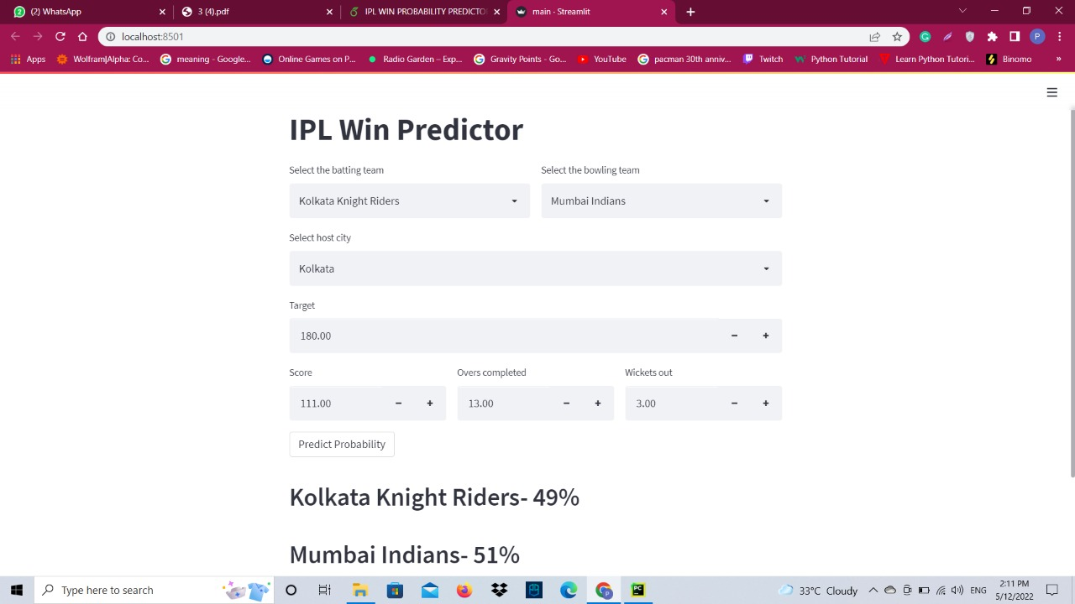
Snapshot

Slide 8
Problem Definition
Given IPL datasets of past 9 years, the main objective of this paper is to predict the outcome of an IPL match
between two teams based on the analysis of previously stored data using Machine Learning algorithms. The
information will be analyzed and preprocessed. After preprocessing the data will be used to train different
models in order to give the outcomes. We will analyze the various datasets and use key variables such as strike rate, bowler economy, etc. and feed it as input to an algorithm will help us get the probable outcome of a match.

Slide 9
Advantages
Records of the past performance of players and other related data can be analysed to create models that predicts the winning team.
In this model , we do some EDA on the IPL dataset to find out some important factors in determining the winning team and also try to predict the outcome of IPL matches using some Supervised Machine Learning Algorithms.
we often see the scoreline showing the probability of the team winning based on the current match situation. This prediction is usually done with the help of Data Analytics.
One of the most important advantage of this model is change in venue can affect the winning probability of teams.

Slide 10
Disadvantages
Data Acquisition – “Machine learning models use a lot of data for training and testing. This necessitates large data sets to train on”.
Resource demand.
Result interpretation.
Algorithm identification.
Susceptibility to errors.

Slide 11
Conclusion
Predicting a winner in a sport such as cricket is especially challenging and involves very complex processes. But with the introduction of machine learning, this can be made much easier and simpler. In this project, various factors have been identified that contribute to the results of the Indian Premier League matches. Factors that have a major impact on the outcome of an IPL match include the teams playing, the venue, the city, the batting team and the bowling. We have analyzed IPL data sets and predicted game results based on the current score of match.

Slide 12
Reference
https://towardsdatascience.com
https://www.youtube.com/user/krishnaik06
https://www.kaggle.com
http://www.campusx.in
R. Rein and D. Memmert, “Big data and tactical analysis in elite soccer: future
challenges and opportunities for sports science,” SpringerPlus, vol. 5, no. 1, p. 1410, 2016

Slide 13
THANK YOU

